Slide 1
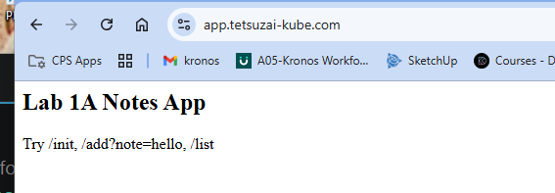
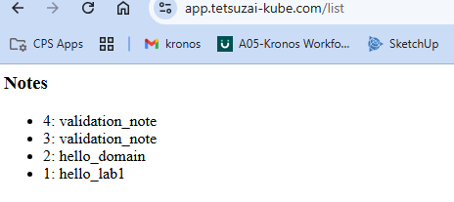
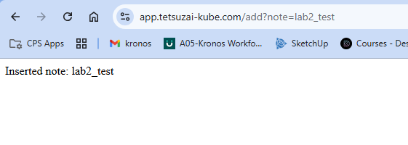
Testing these out after all the tf have been approved
https://app.tetsuzai-kube.com
https://app.tetsuzai-kube.com/list
https://app.tetsuzai-kube.com/add?note=lab2_test
So now cloudfront and https work
Dynamic read endpoint works
Dynamic write endpoint works

Slide 2
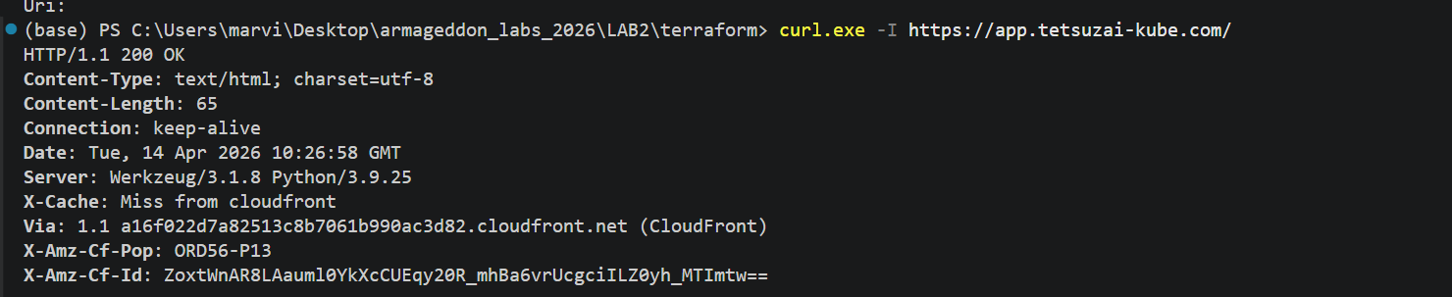
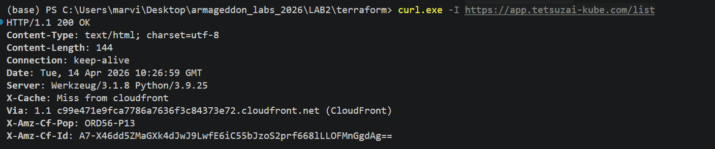

Slide 3
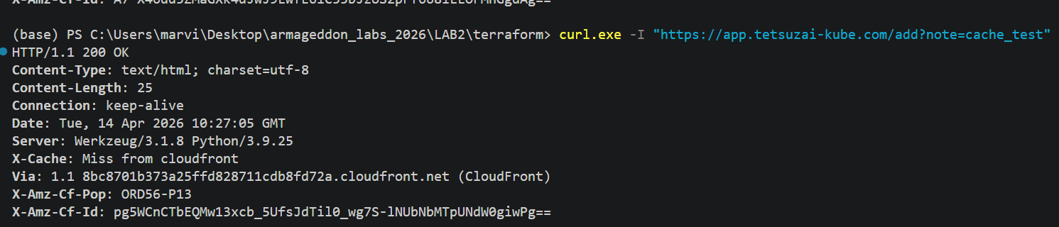
all three header checks ran successfully, then my cache-routing path is functioning

Slide 4
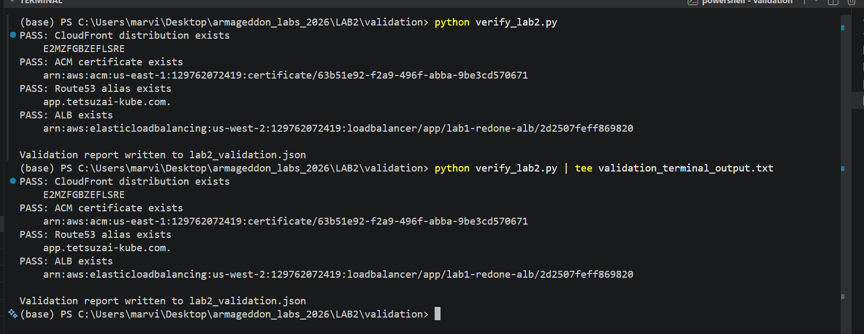
Validators passed
Python evidence

